Slide 1
Clay for Change

Slide 2
“Art has a way to connect people, to motivate and move people into action”
-Marcus Ellsworth

Slide 3
You will create a work of art that takes a stance on an issue that is important to you or the community you live in.
Social, Political, Environmental, etc.

Slide 4
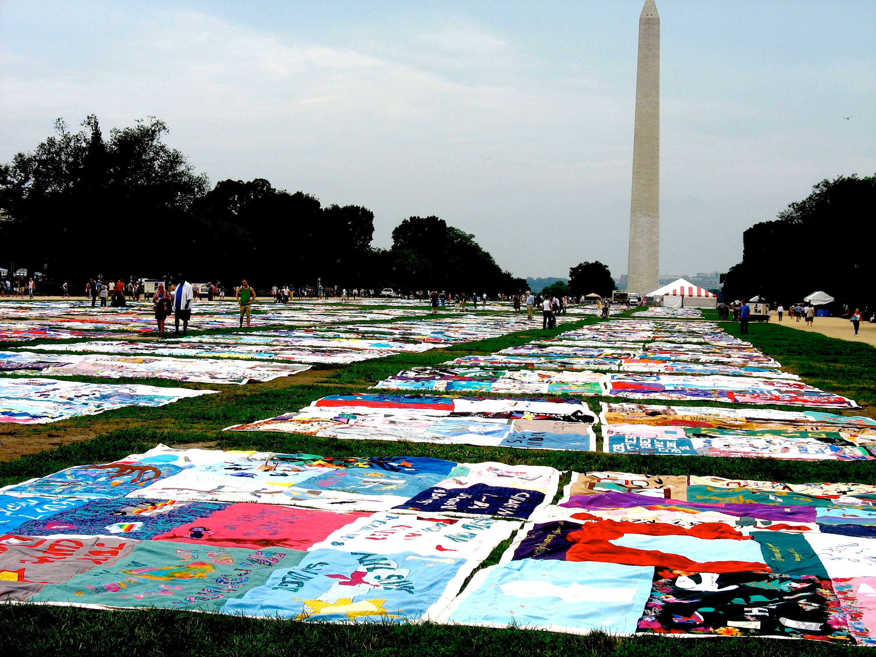
The NAMES Project
“AIDS Memorial Quilt
June 1987 - Present
The ongoing project memorializes those who have died from HIV and AIDS through quilted panels, embellished with their names and symbolic imagery representing the person memorialized. Currently, the quilt is made up of more than 48,000 panels, with more added every year as more AIDS casualties are submitted.
National Mall, Washington DC

Slide 5
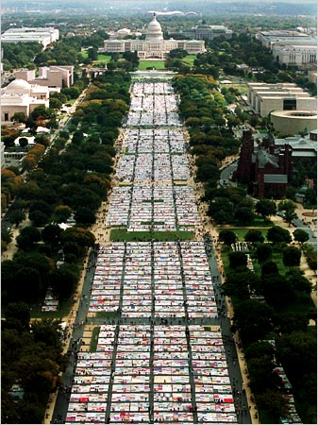
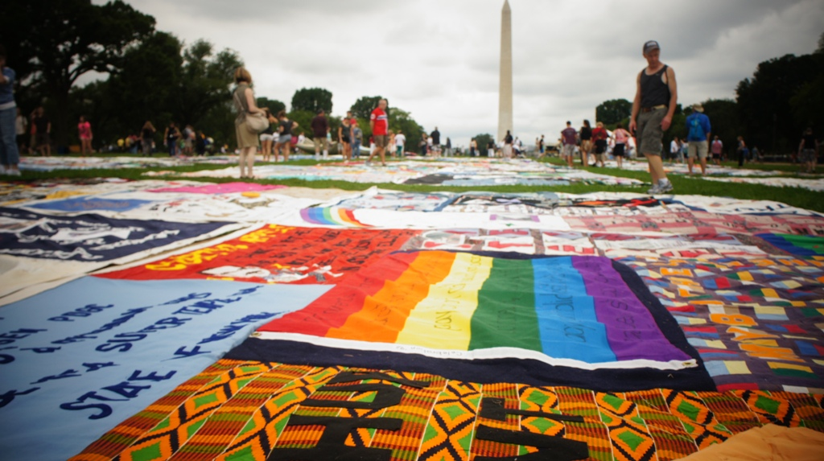

Slide 6
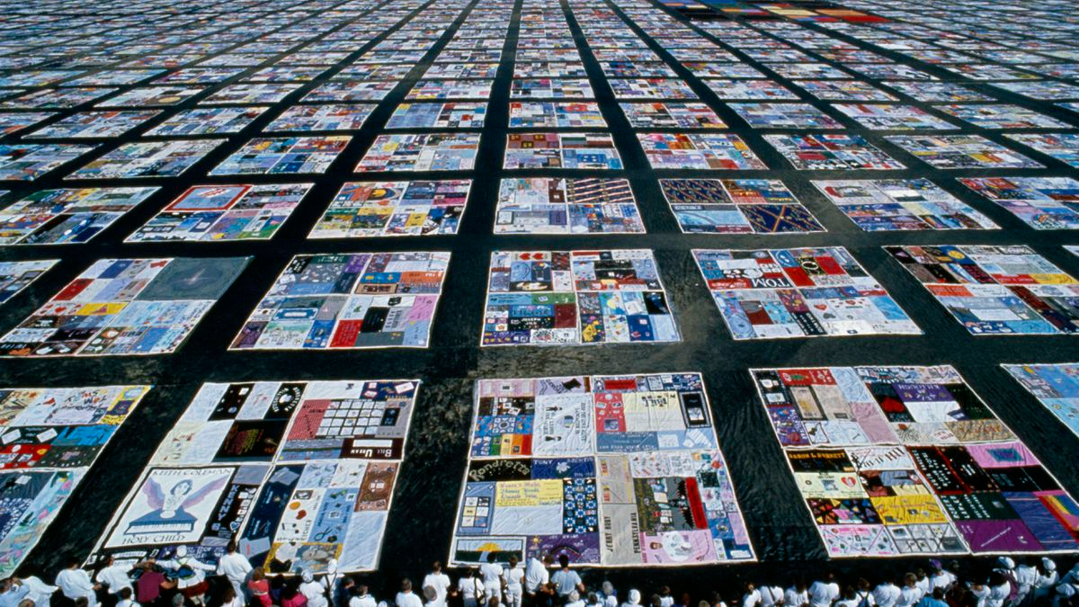

Slide 7
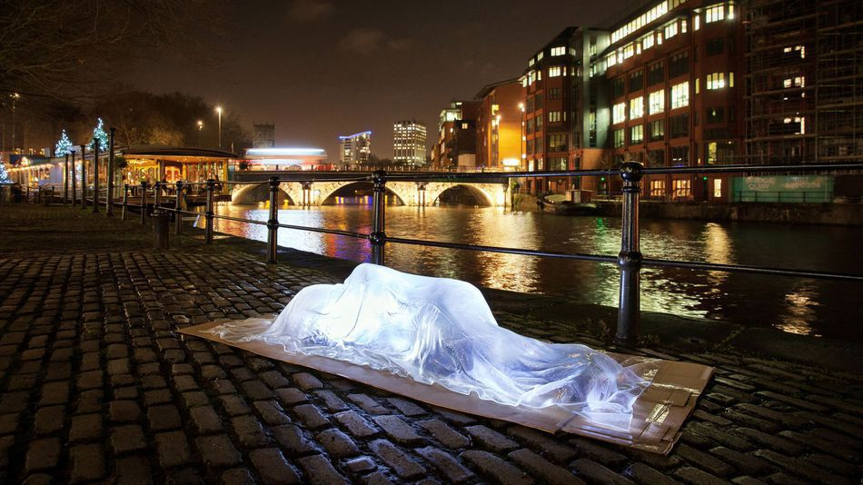
Luke Jeram
“Invisible Homeless”
England, 2015
Glass figure resting on a cardboard base

Slide 8
STOP TELLING WOMEN TO SMILE

Slide 9
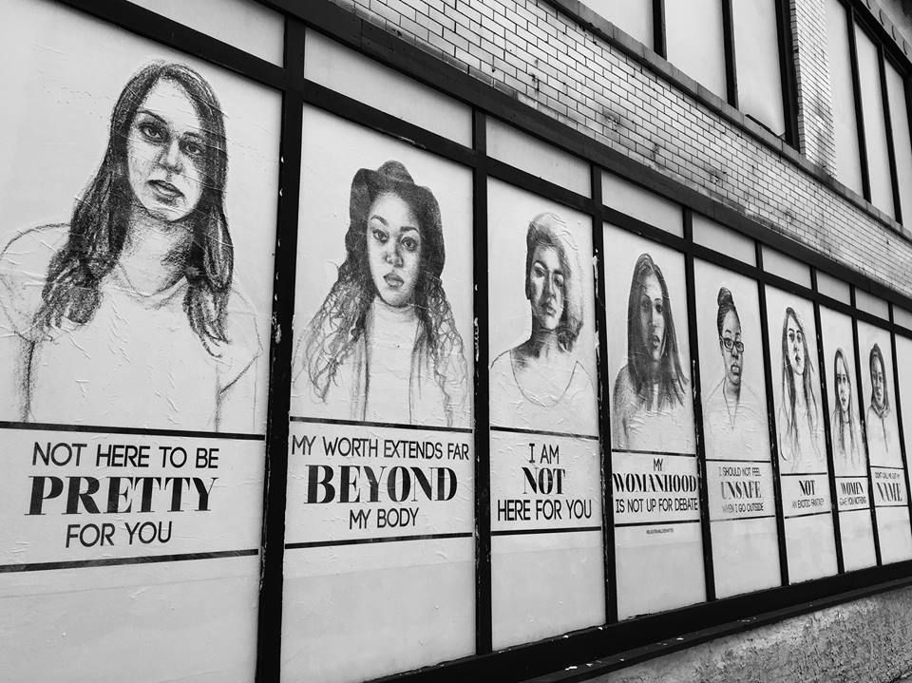
Tatyana Fazlalizadeh
“Stop Telling Women To Smile”
Brooklyn, NY
2012

Slide 10
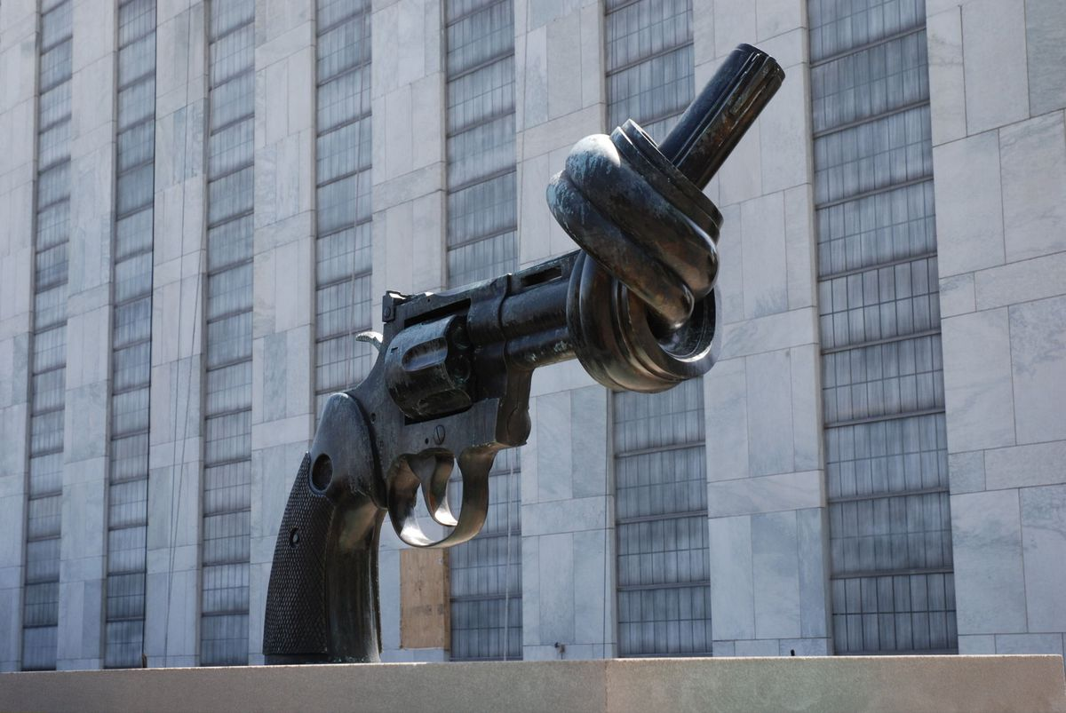
Carl Fredrik Reuterswärd
“Non-Violence”
New York City, 1980
Created after the murder of John Lennon

Slide 11
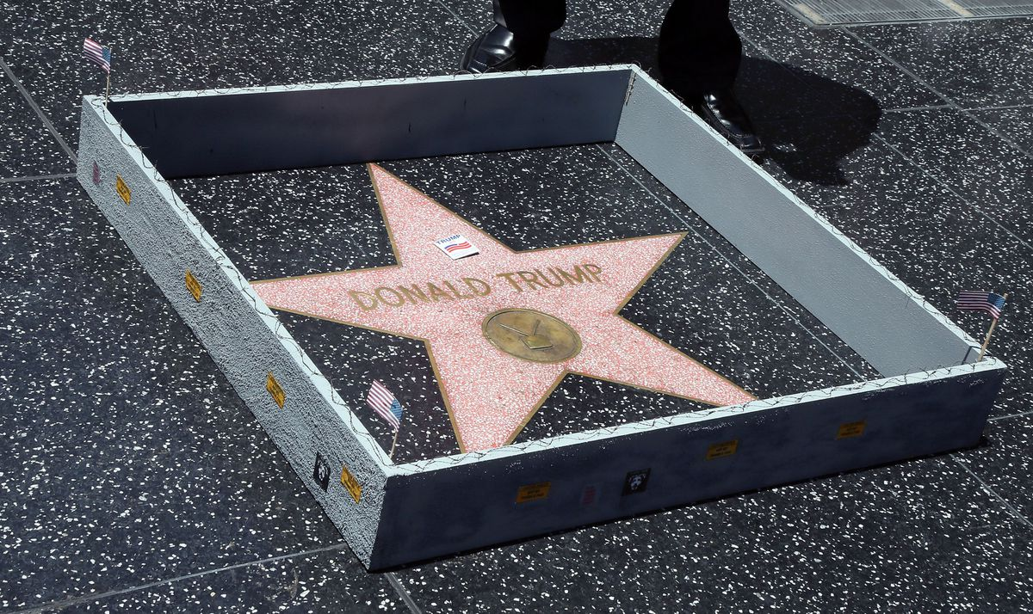
Complete with barbed wired and tiny "Keep Out" signs, the work played on Trump's controversial statements about building a wall on the southern border of the U.S. as part of a plan for immigration reform.
Plastic Jesus
Hollywood Walk of Fame, 2016

Slide 12
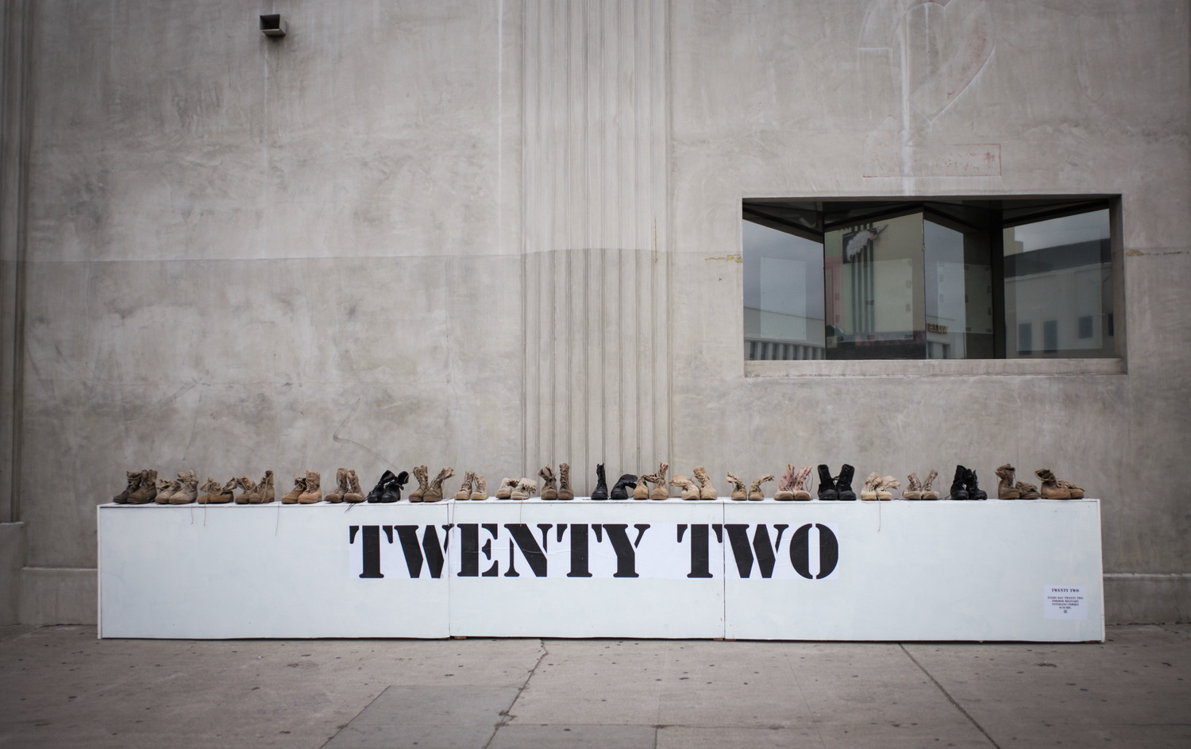
Plastic Jesus “Twenty Two”
Los Angeles, 2016
Every day, twenty-two former military veterans commit suicide

Slide 13
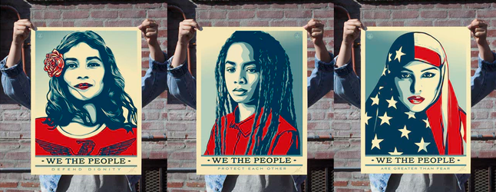
Shephard Fairey
“We The People” Los Angeles, 2016
“We The People…
...Defend Dignity
...Protect Each Other
...Are Greater Than Fear”

Slide 14
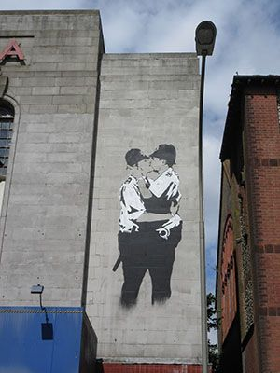
Banksy 2004 British Graffiti Artist
“Kissing Coppers”
Banksy is advocating for a sexual-identity accepting society by placing icons of authority in a pro-gay position. His use of policemen, rather than ordinary citizens, is intriguing, because the very subjects of his tender portrayal are often the ones to working to eradicate his vandalism.

Slide 15
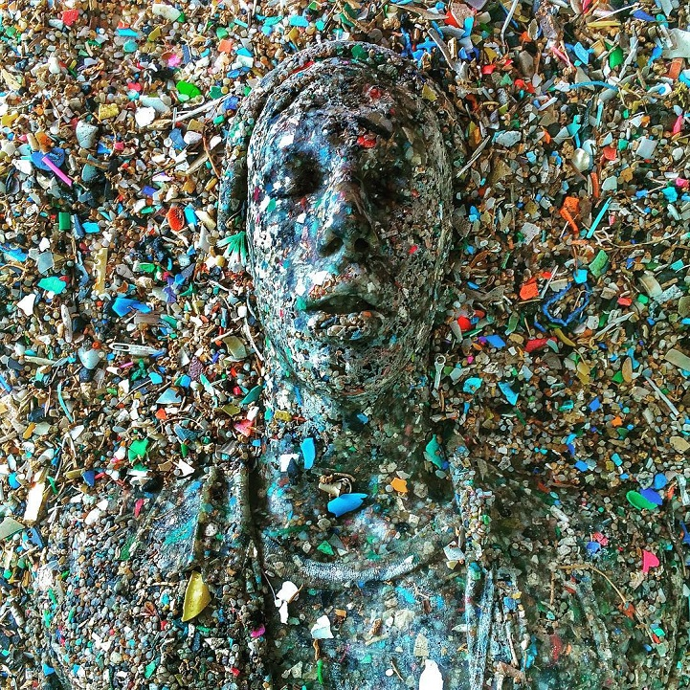
Jason DeClaire Taylor: Artist
Sculpture made from micro plastics washed up by the Atlantic Ocean

Slide 16
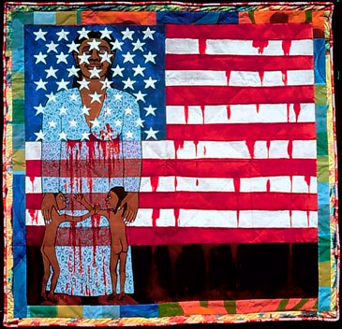
Faith Ringgold
“The Flag is Bleeding”
Harlem, 1970
Quilt

Slide 17
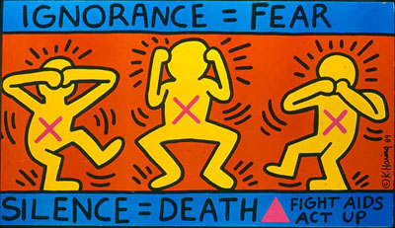
Keith Haring
“Silence=Death”
New York City, 1989

Slide 18
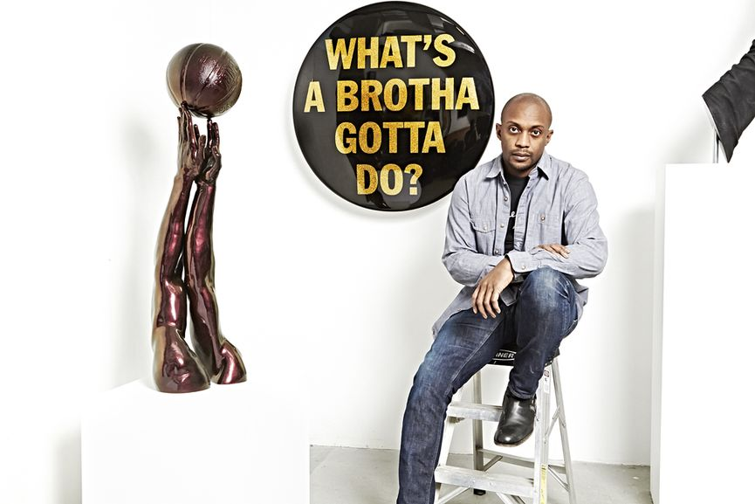
A conceptual artist living and working in New York City, Hank Willis Thomas centers his work around themes related to perspective identity, commodity, media and popular culture. He often incorporates recognizable advertising icons and imagery in his work. Commenting on advertising, he stated: “Part of advertising’s success is based on its ability to reinforce generalizations developed around race, gender and ethnicity which are generally false, but [these generalizations] can sometimes be entertaining, sometimes true, and sometimes horrifying.”
B®anded and Unbranded: Reflections in Black by Corporate America 1968-2008, a work created from appropriated advertising imagery.

Slide 19
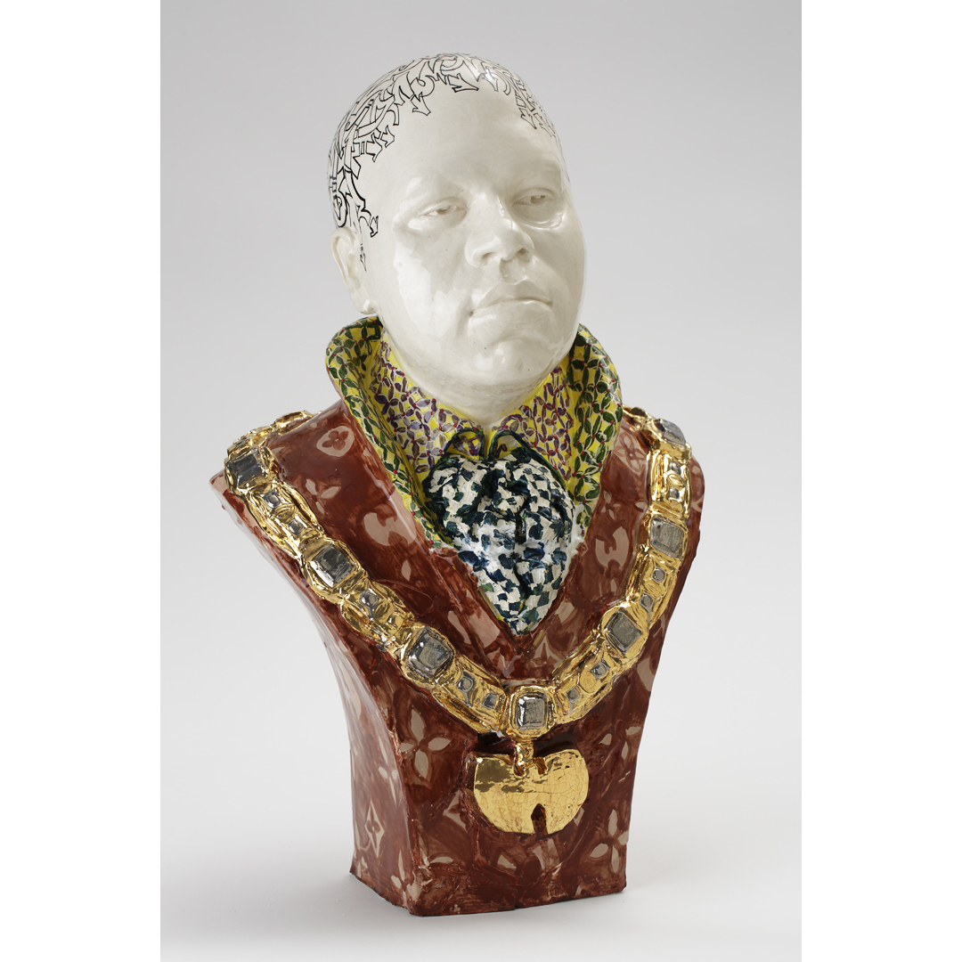
Roberto Lugo
Ceramic Artist

Slide 20
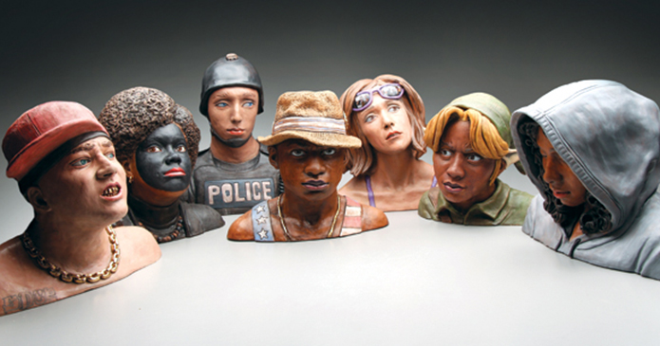
Ceramic artist Nathan Murray challenges systematic racism through the creation of ceramic sculptures.

Slide 21
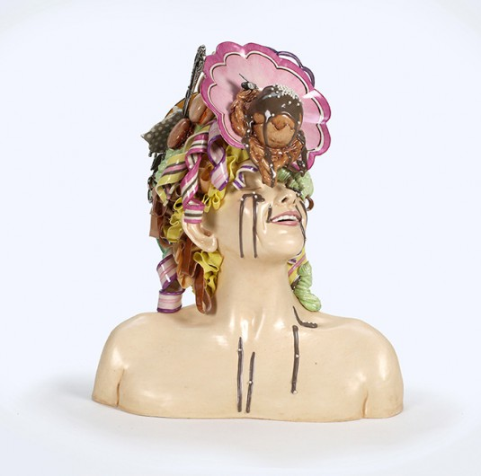
Jessica Stoller’s ceramic objects recall the figures and slick surfaces of dainty European porcelain sculptures, or Dutch still life vanitas paintings, but they tackle ideas such as feminine beauty ideals, or greed, taking the form of female busts or body parts bedecked with fine frocks and sugary treats.

Slide 22
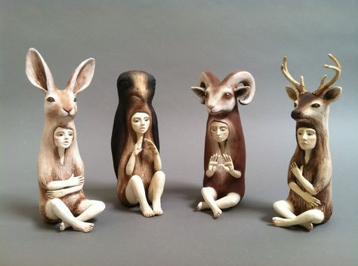
Crystal Morey’s mythical porcelain pieces also comment on humankind’s perilous effect on the natural world.

Slide 23
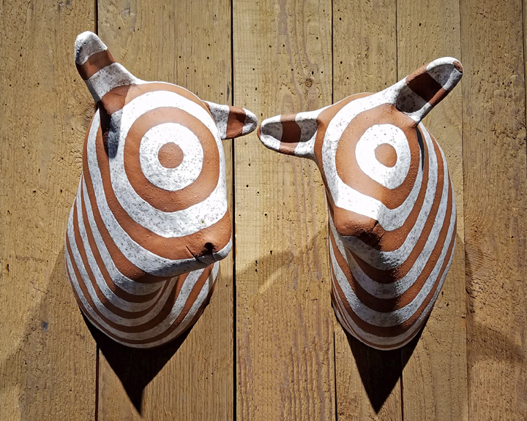
Undine Brod’s work, including these trophy-head animal composites, comment on the manipulation and abuse of animals by the human race

Slide 24
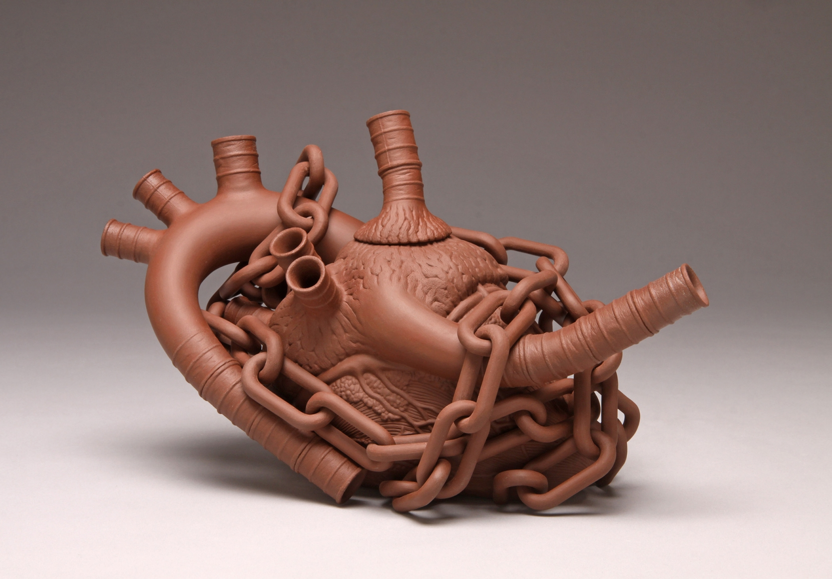
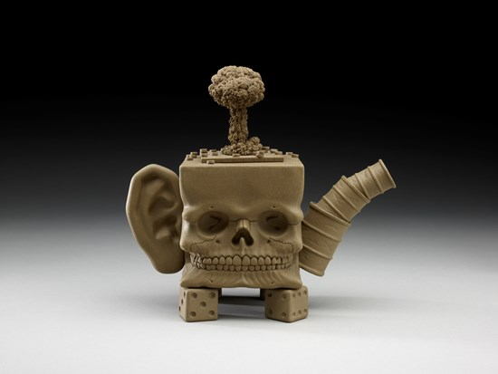
Richard Notkin
Influenced by the tradition of Yixing pottery, his work is a vehicle for political commentary

Slide 25
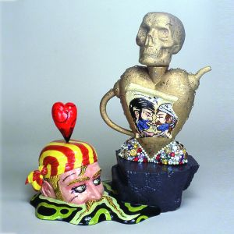
Mark Burns has a keen sense of ceramic history and pop culture, which he uses to express complex cultural notions of sexuality and identity.

Slide 26
You will find a cause you are passionate about, or even excited about and want to learn and explore and use clay to create a sculpture with a point of view. The goal is to for each student to come up with something that concerns them about society, the environment, politics, etc. The topic should be something that you care enough about in an area where you actively want to see change.
You will use symbols to convey your ideas.

Slide 27
Social Change Project Requirements:
Your Sculpture Must. . .
-Make a statement about a change you would like to see in the world.
- Show a strong point of view and have visual impact.
-Utilize at least 2 or more sculpted elements. Should not be overly simplistic (have some large and small components). Surface should have attachments and/or carving and other detail.
-Incorporate the use of symbols to convey meaning.
-Look interesting from all sides
-Be able to sit or stand on it’s own
-Utilize pinch, slab, coil or solid sculpting.
-Be well crafted. Your message will less clear if craftsmanship is an after-thought.
-Size: 6x6-8x8

Slide 28
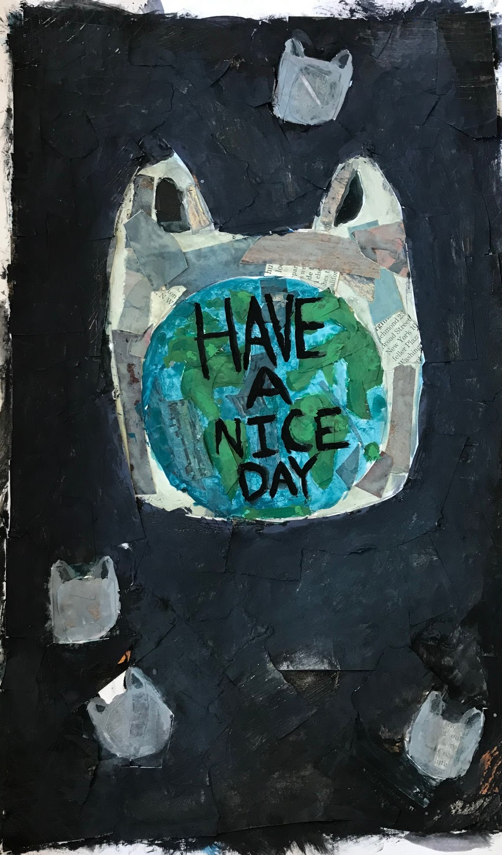
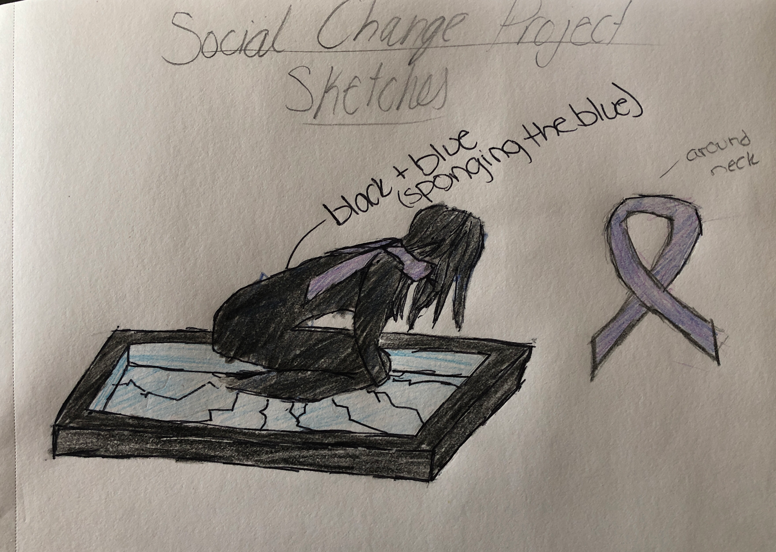
Student Ideas (2D Examples/Ideation)

Slide 29
